Slide 1
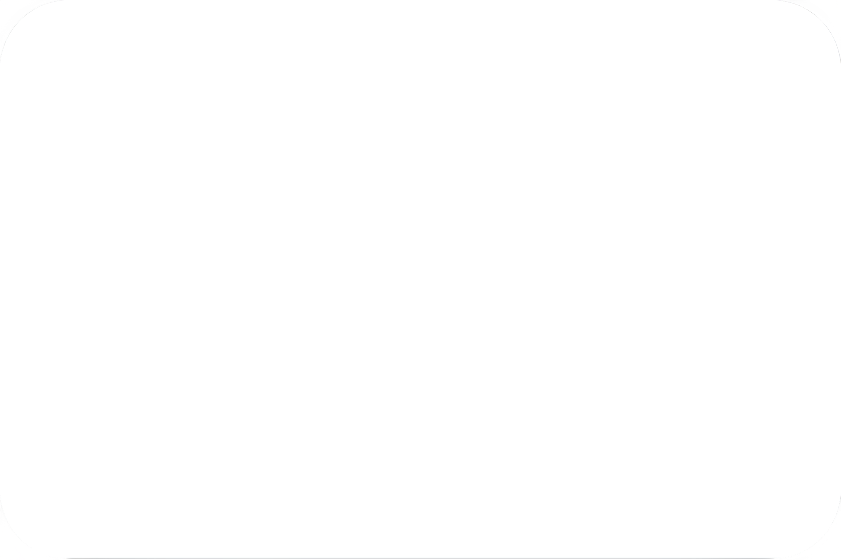
CA2 - Generative Adversarial Networks Analysis: CIFAR10
Name: Quah Johnnie
Admin No: 2007476

Slide 2
Contents (Slides)
1.0: Intro GAN & CIFAR10 | Overview of CIFAR10 | Introduction to GAN & Ideology
2.0: Data Engineering | Preparing data for GAN training
3.0: Metrics | Available metrics, what do the metrics they stand for?
4.0: Training & Evaluation | Simple DCGAN & cDCGAN | Evaluation & Results
5.0: Training & Evaluation (Advanced Architectures) | BigGANs & Complex Architectures | Evaluation & Results
6.0: Image Generation | Truncation trick | Observing Final Images
7.0: Conclusion | -

Slide 3
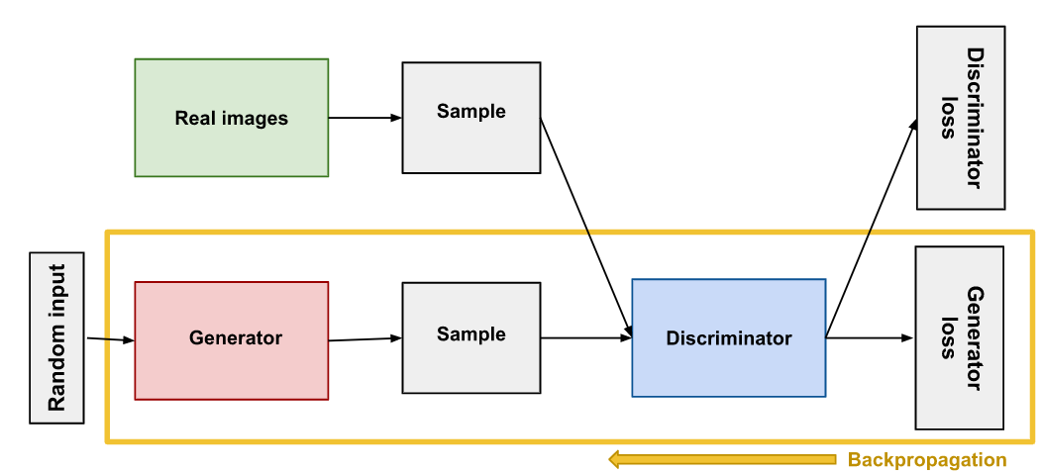
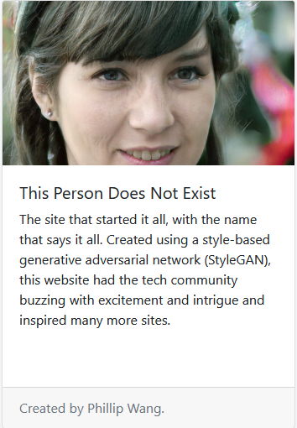
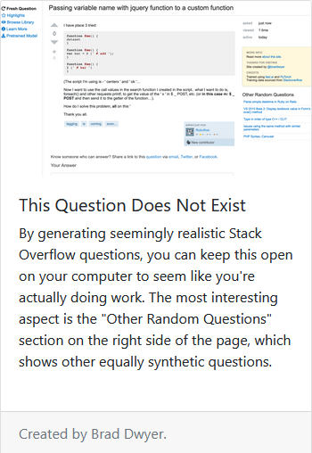
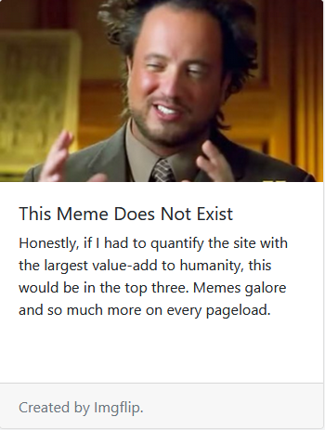
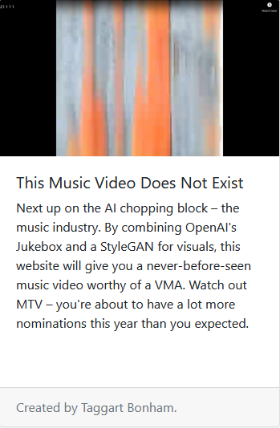
1.0) GAN? What's GAN
he
https://thisxdoesnotexist.com/
https://www.twitch.tv/watchmeforever
Two competing neural networks: Generator + Discriminator:
Generator’s Ultimate Goal: Produce fake data that is indistinguishable from real data
Discriminator’s Ultimate Goal: Correctly identify whether a given sample is real or fake
Image Generation
Text Synthesis
Meme Generation
Audio + Video Generation

Slide 4
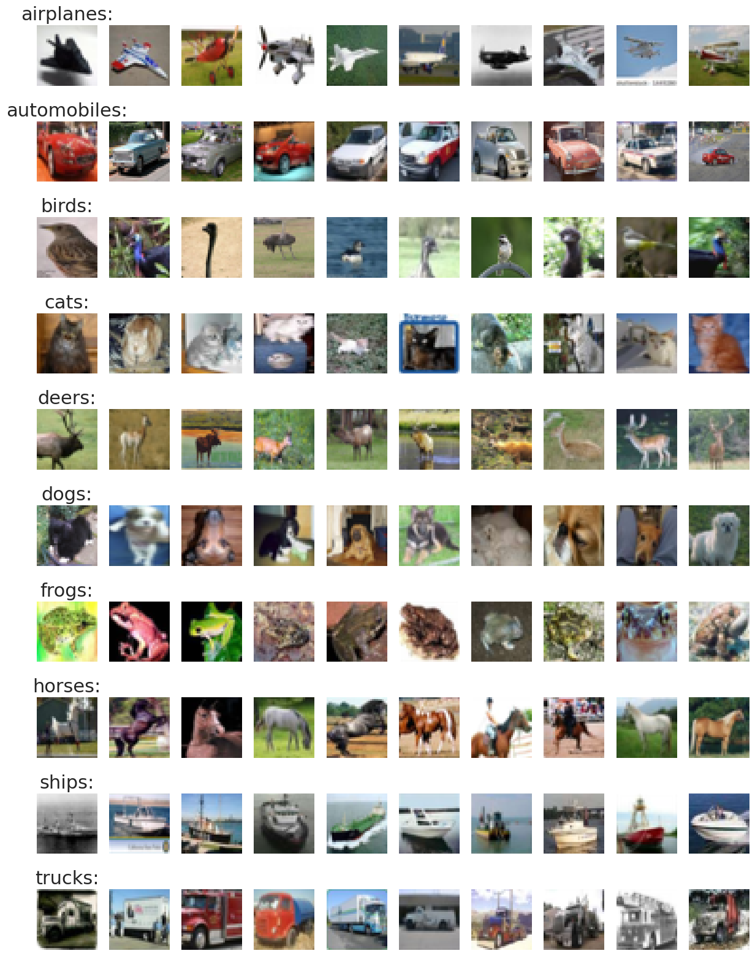
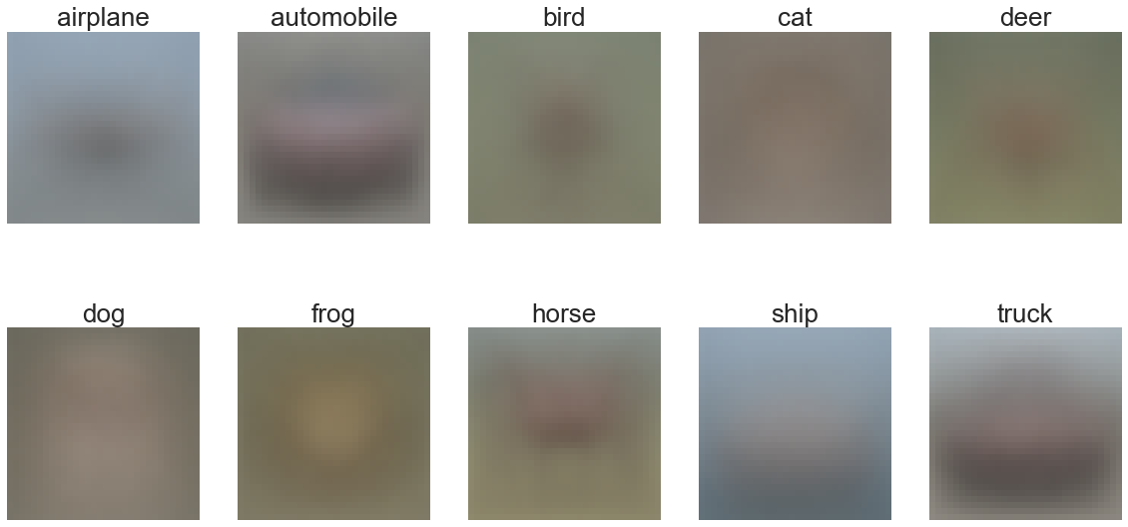
1.0) CIFAR10 Dataset
10 Classes
60,000 Images
Uniformly distributed
32 x 32 Pixel size
The 32x32 pixel size of the images in the CIFAR10 dataset is relatively small, and this may limit the capacity of the GAN to capture the high-level features and patterns in the images.
Image Averages:
Animals have a green-ish background
Objects have a blue or brown-ish background

Slide 5
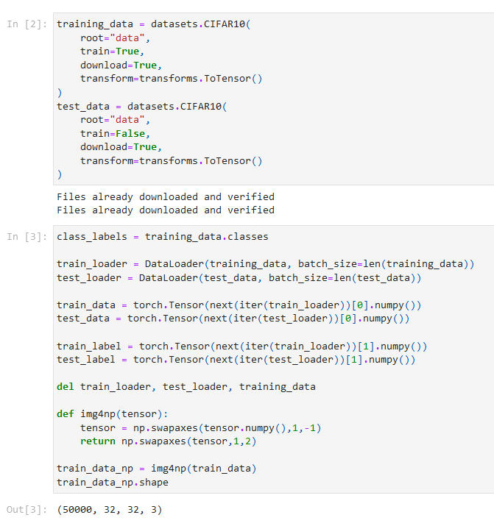
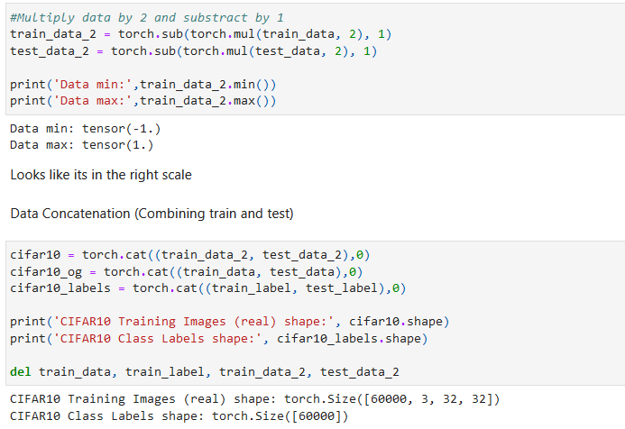
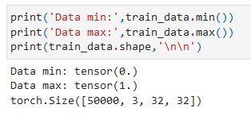
2.0) Data Engineering
Flow:
Download Raw CIFAR10 Data (API) -> Load Into Tensor -> Convert To Desire Value Range -> Data Concat -> Separate Data and Labels -> Ready To Load Into Dataloader -> Train!
-1 to 1 Normalized, Data Concat and Seperate Labels
Download Data and Load to Tensor
0 to 1 Normalized Data (Default)
I have prepared a (-1 to 1) CIFAR Dataset as well as (0 to 1) CIFAR10 Dataset

Slide 6
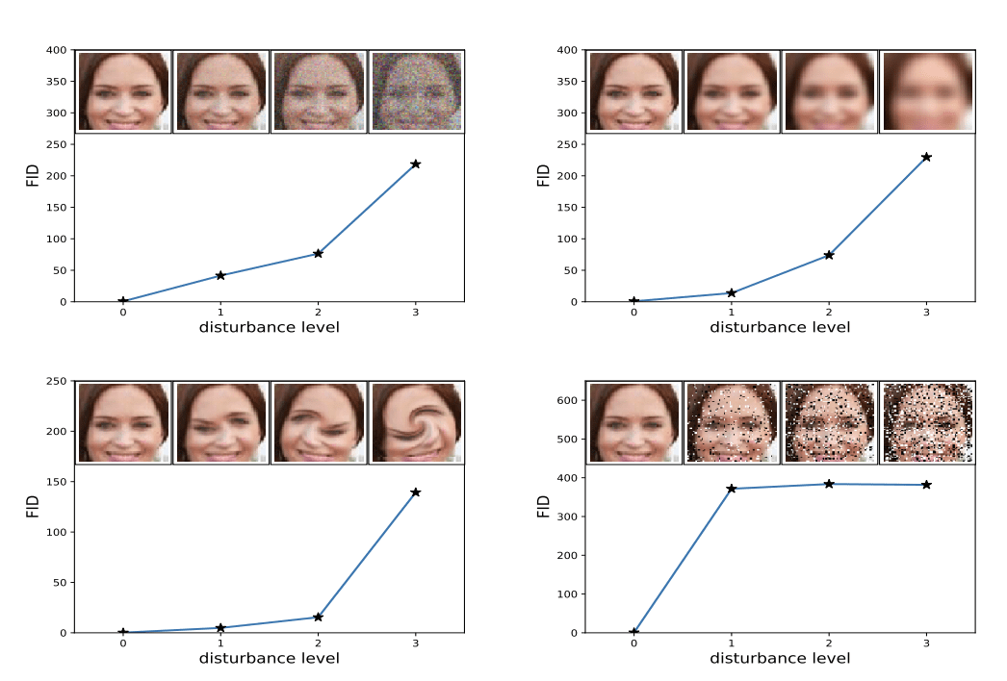
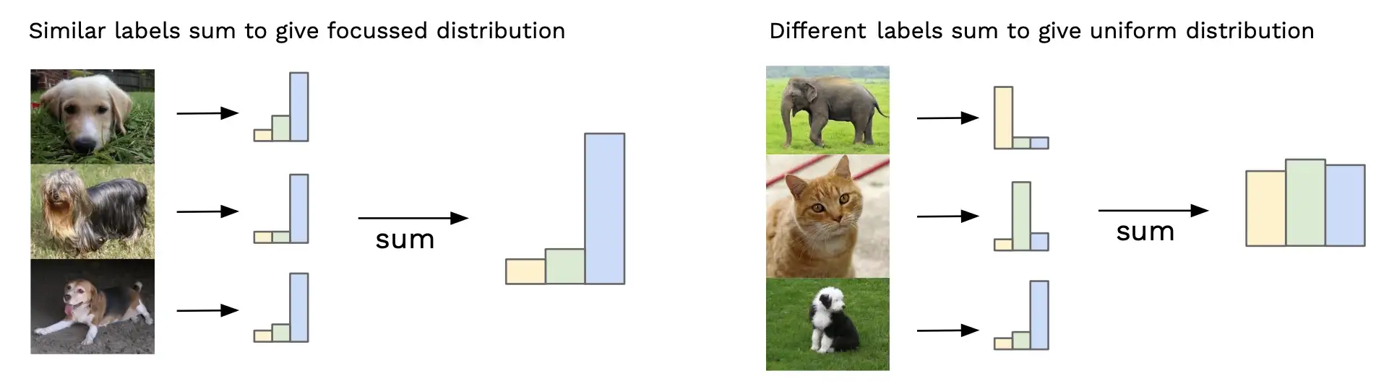
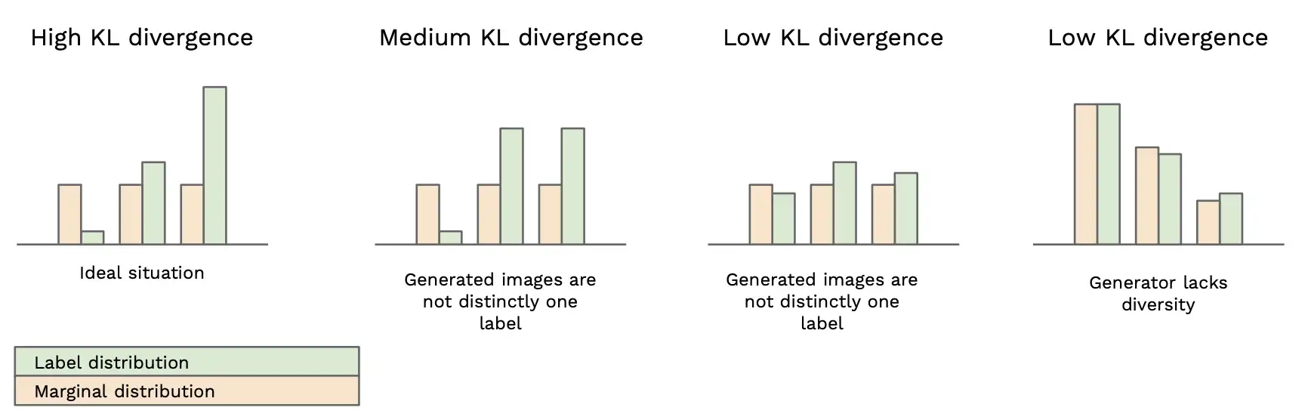
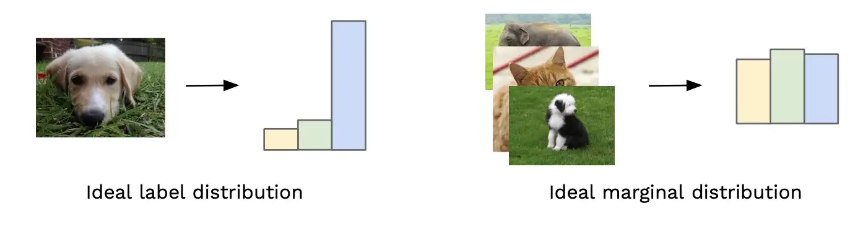
3.0) Metrics Used: FID & IS
Frechet Inception Distance (FID):
It measures the distance between the activations of a pre-trained Inception network when applied to real and generated images. Lower the better (Less disturbance between real vs fake images).
Inception Score (IS):
Measures quality and diversity of generated images. It's based on the KL-divergence between the conditional class distributions in real and generated images.

Slide 7
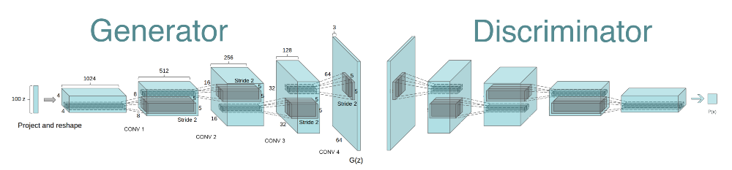
4.0) Simple DCGAN & cDCGAN
The image shows the idea of the architecture I implemented. However, it is not the same as the one I implemented.
Images displayed are as seen in the demo/Jupyter notebook or HTML

Slide 8
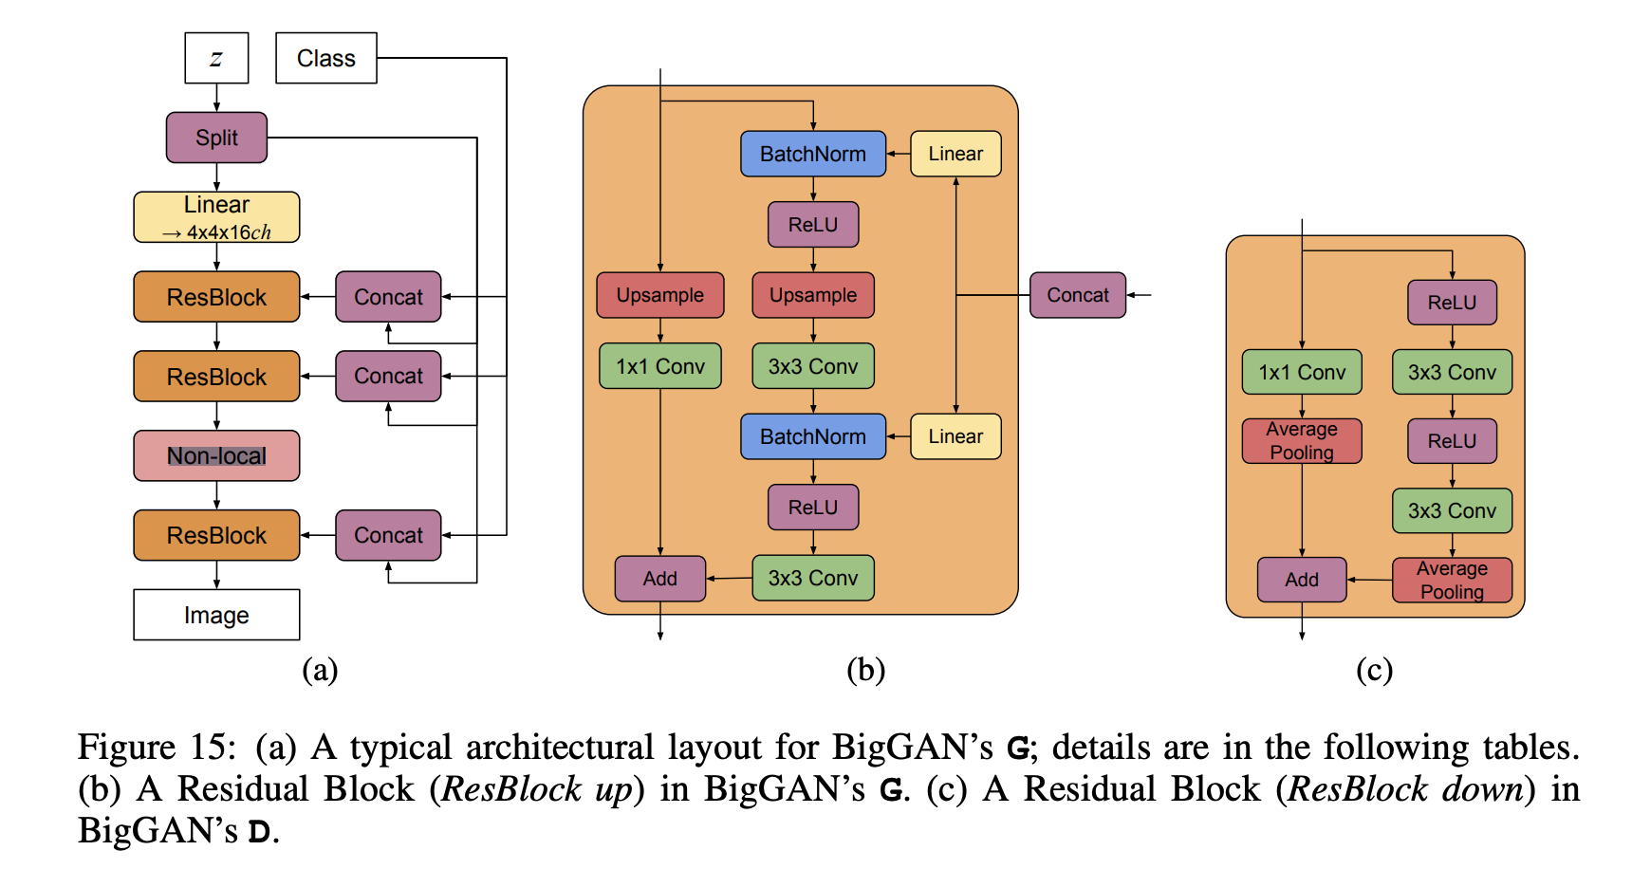
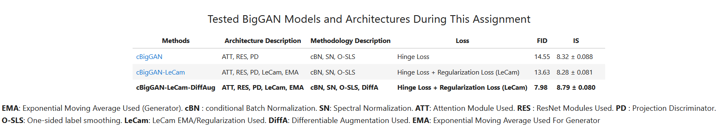
5.0) BigGANs & More
*The BigGAN architecture is built upon multiple architectures, notably its ResNet backbone for both the generator and discriminator
Images displayed are as seen in the demo/Jupyter notebook or HTML

Slide 9
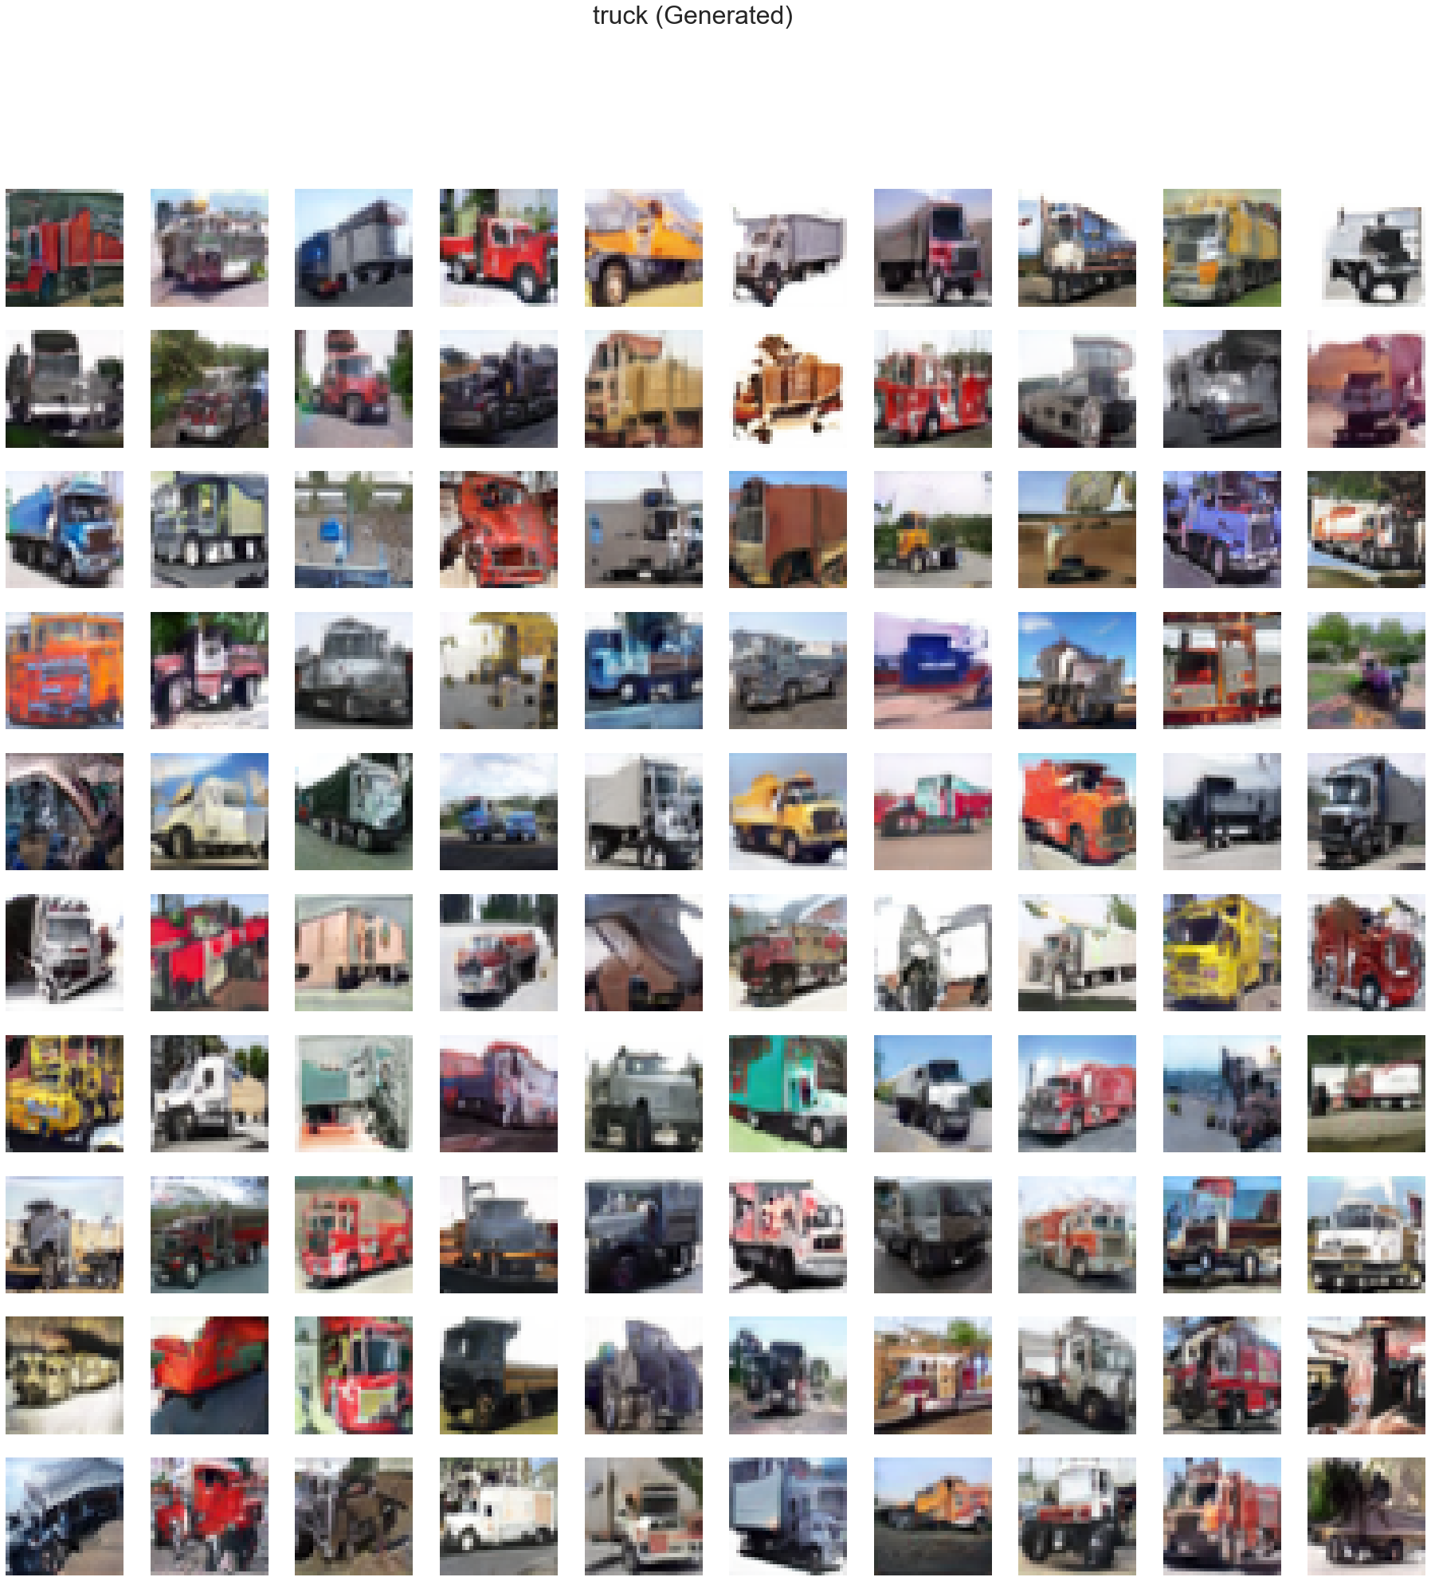
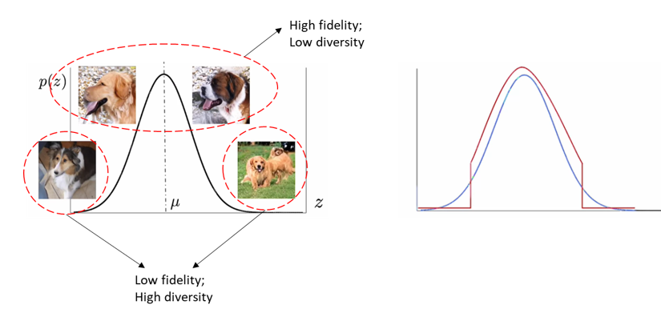
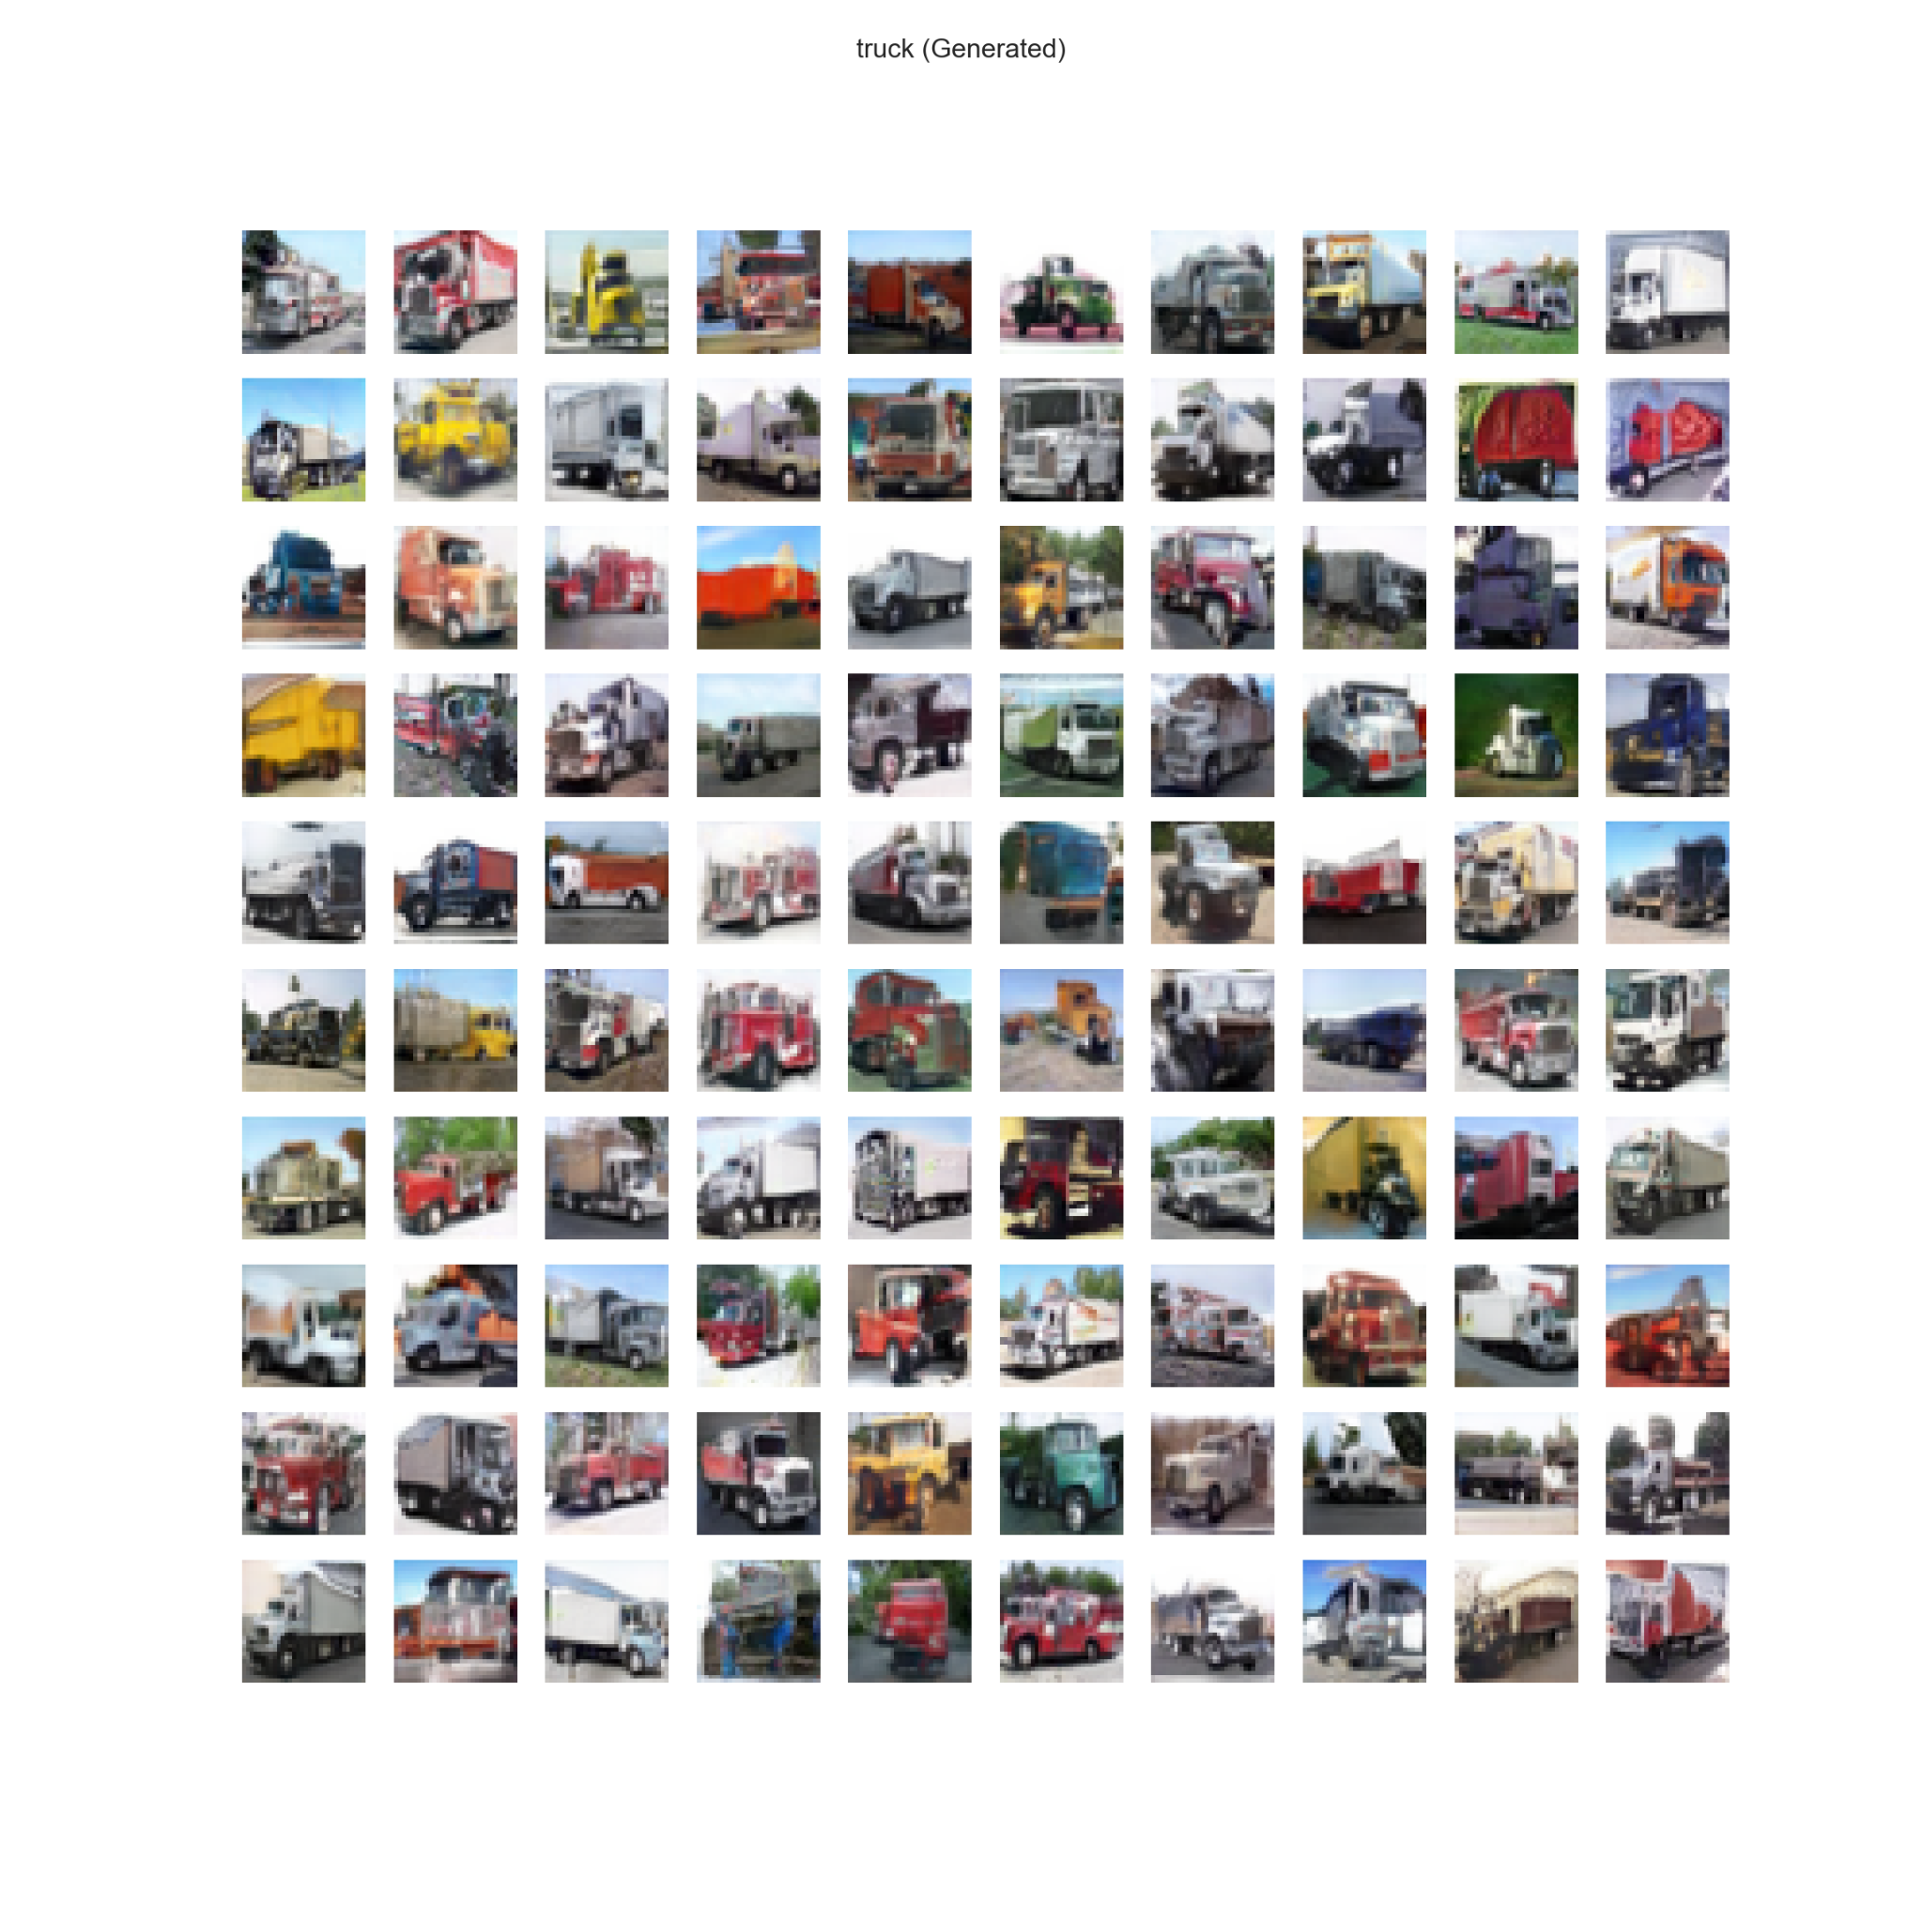
6.0) Image Generation /w Truncation Trick
Normal Generation
Truncation trick can decrease FID scores and improve the quality of generated images by discarding those with high FID. However, it often comes at the cost of increased computation power and decreased image diversity.
Truncation Trick

Slide 10
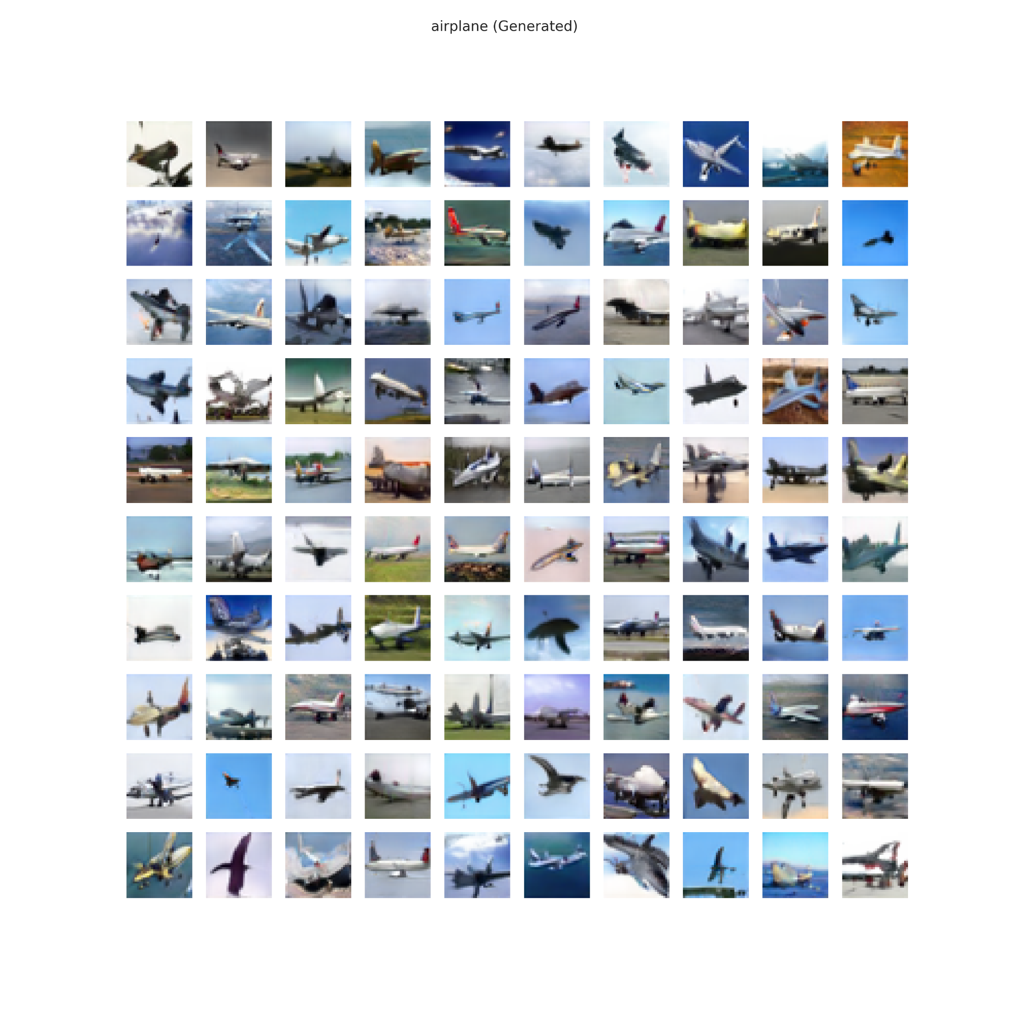
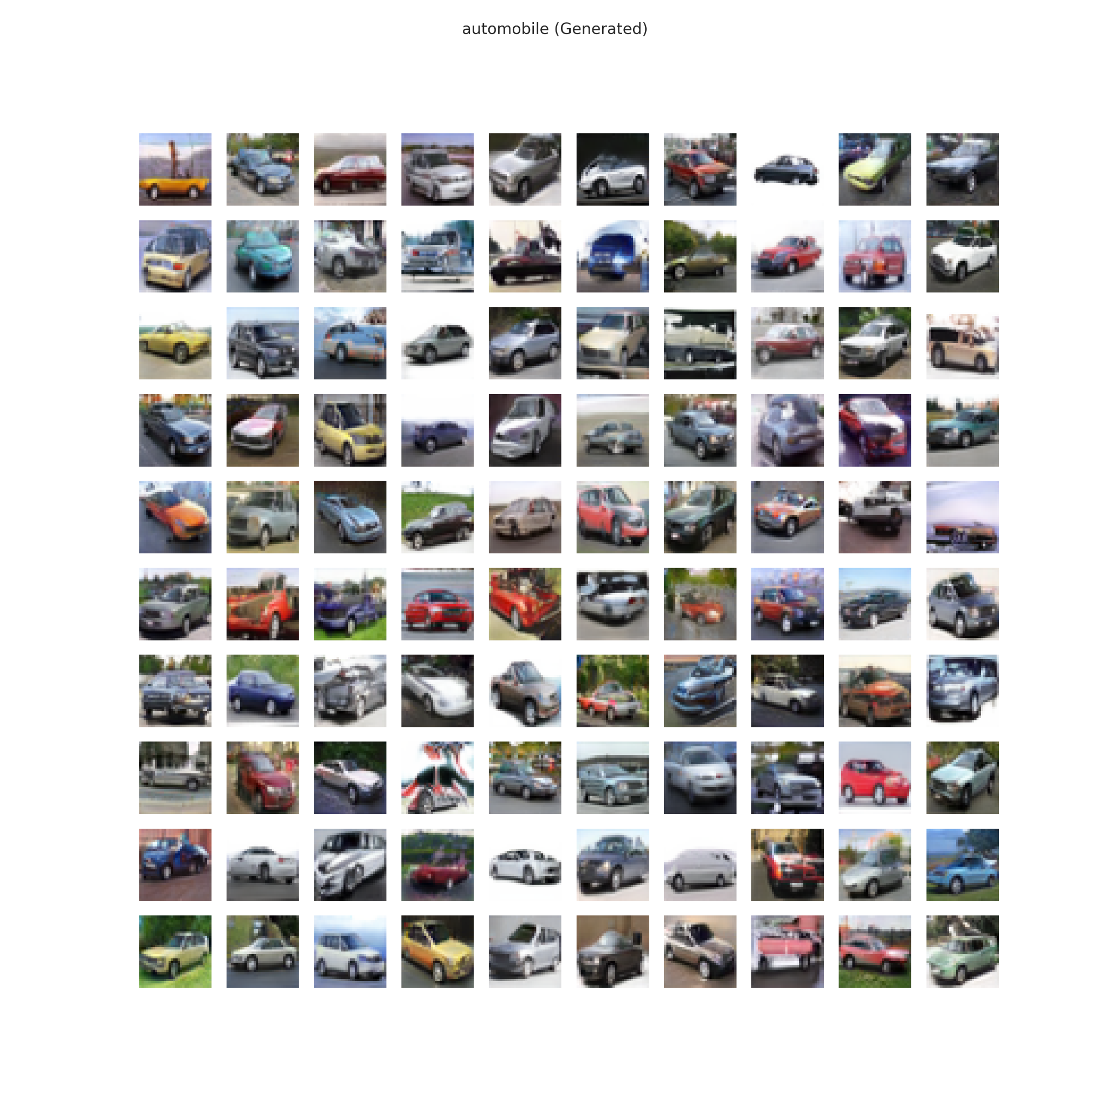
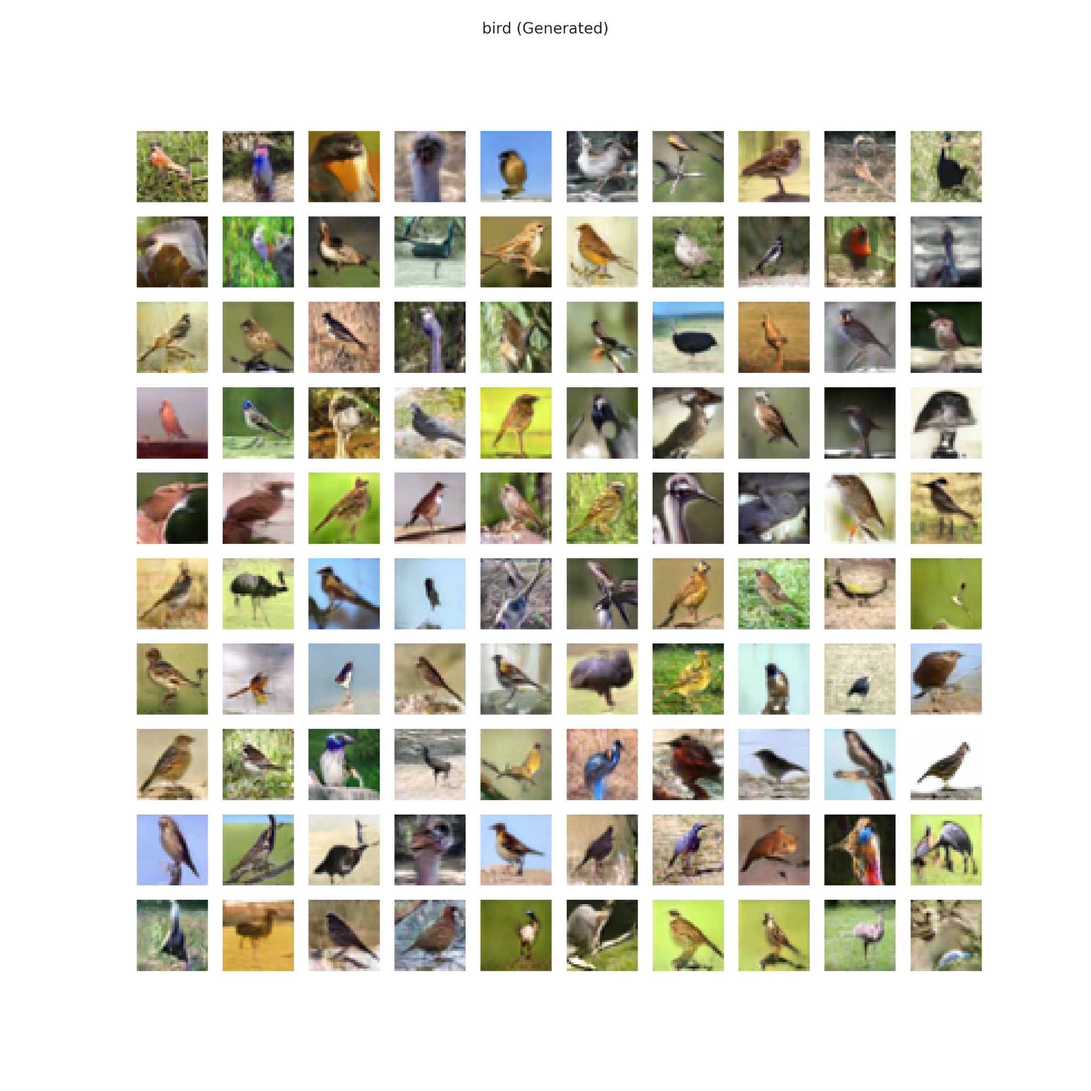
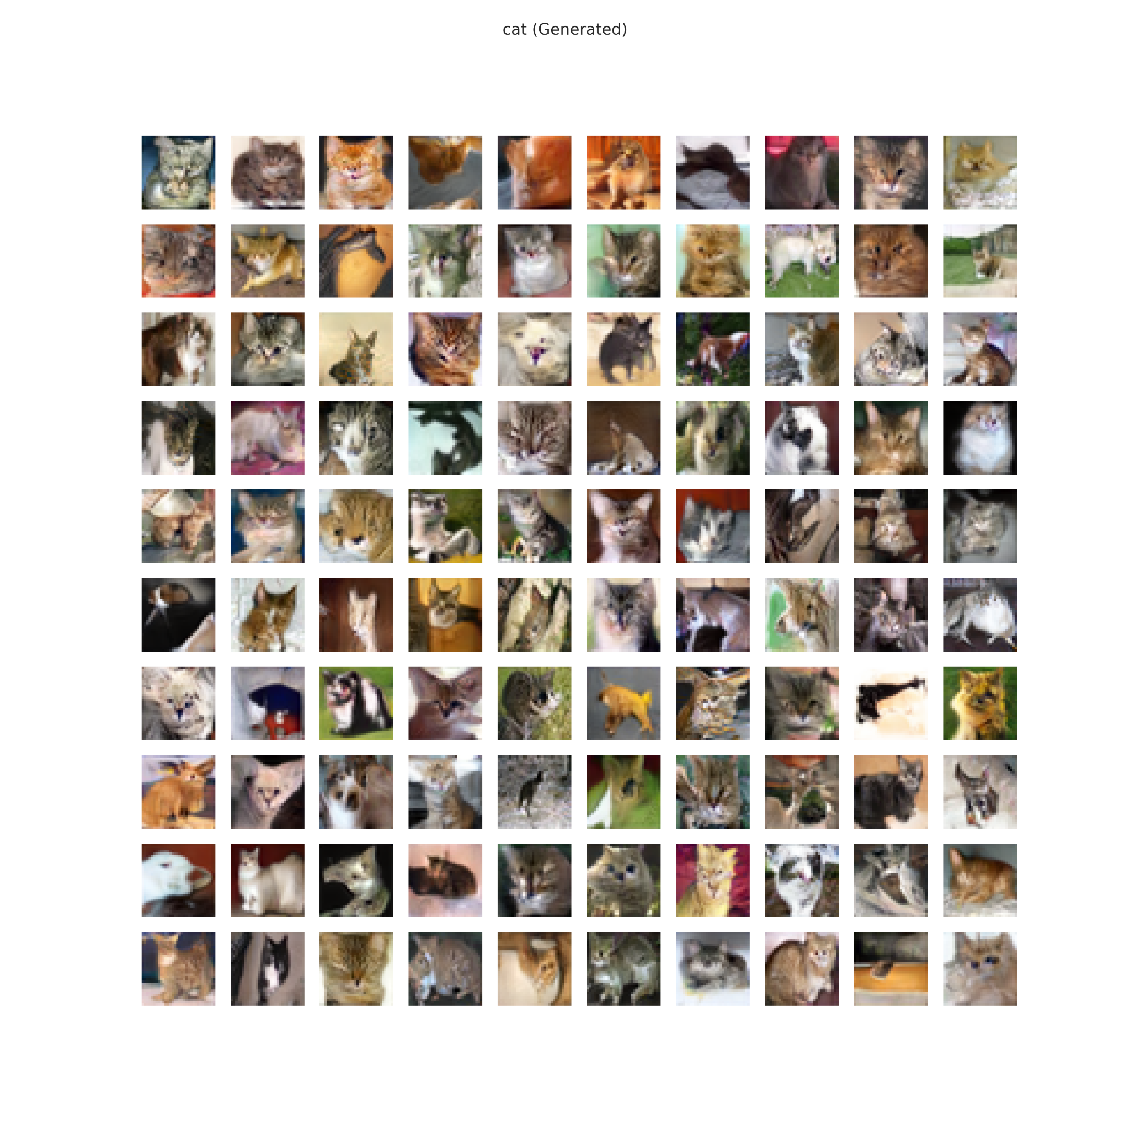
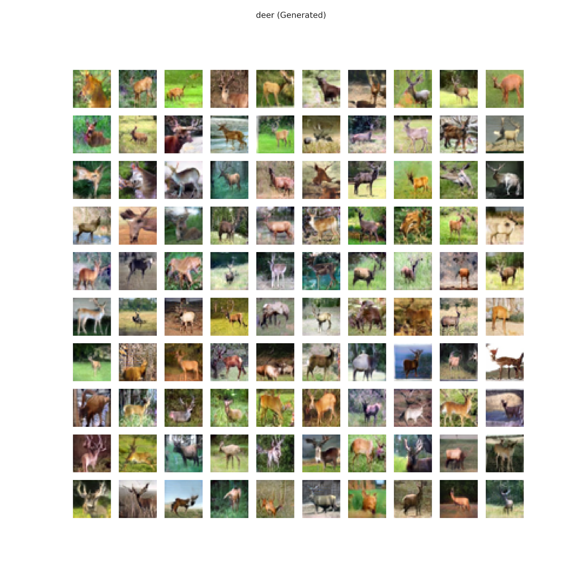
6.0) Images Generated
–> ./images/submission/GAN_100_Generated_{class}

Slide 11
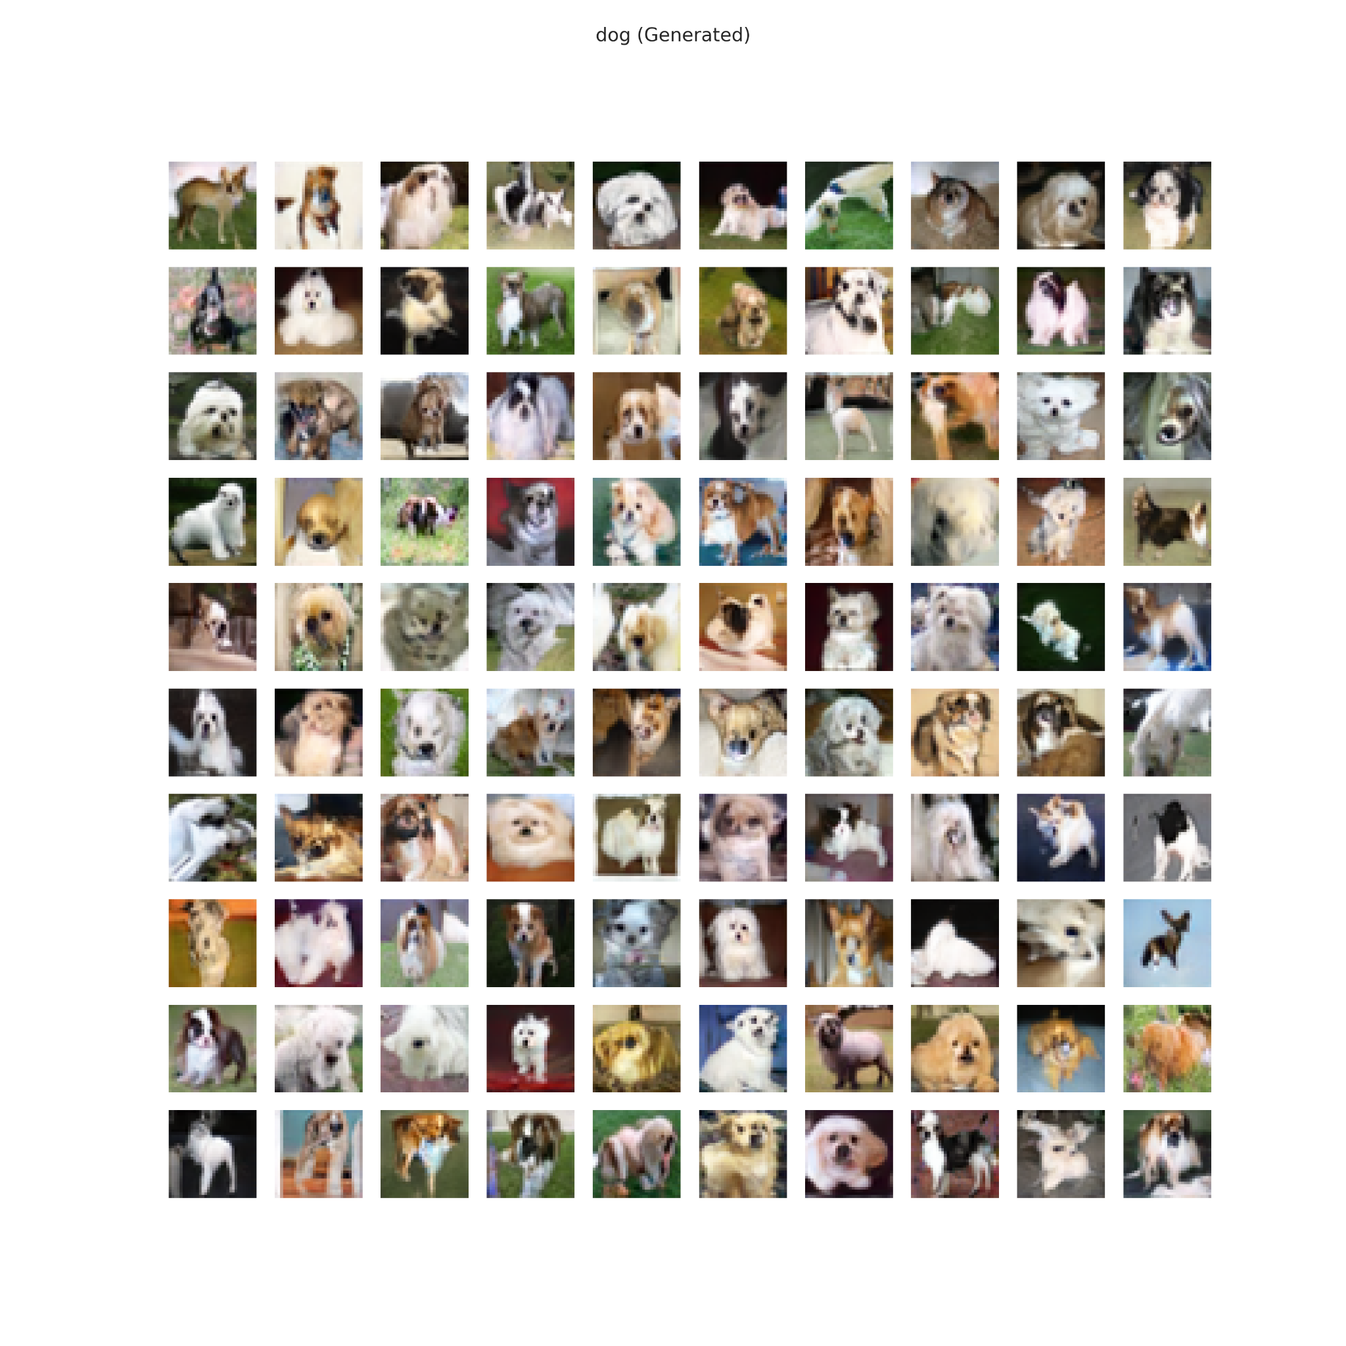
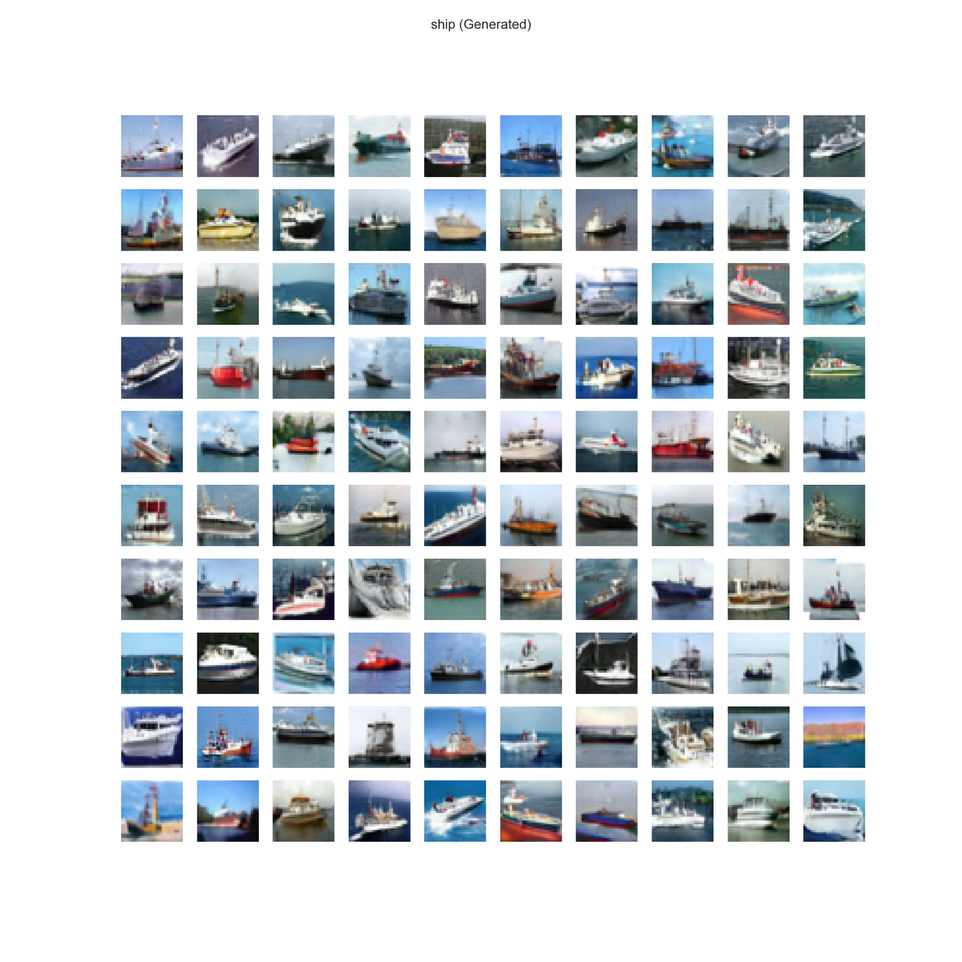
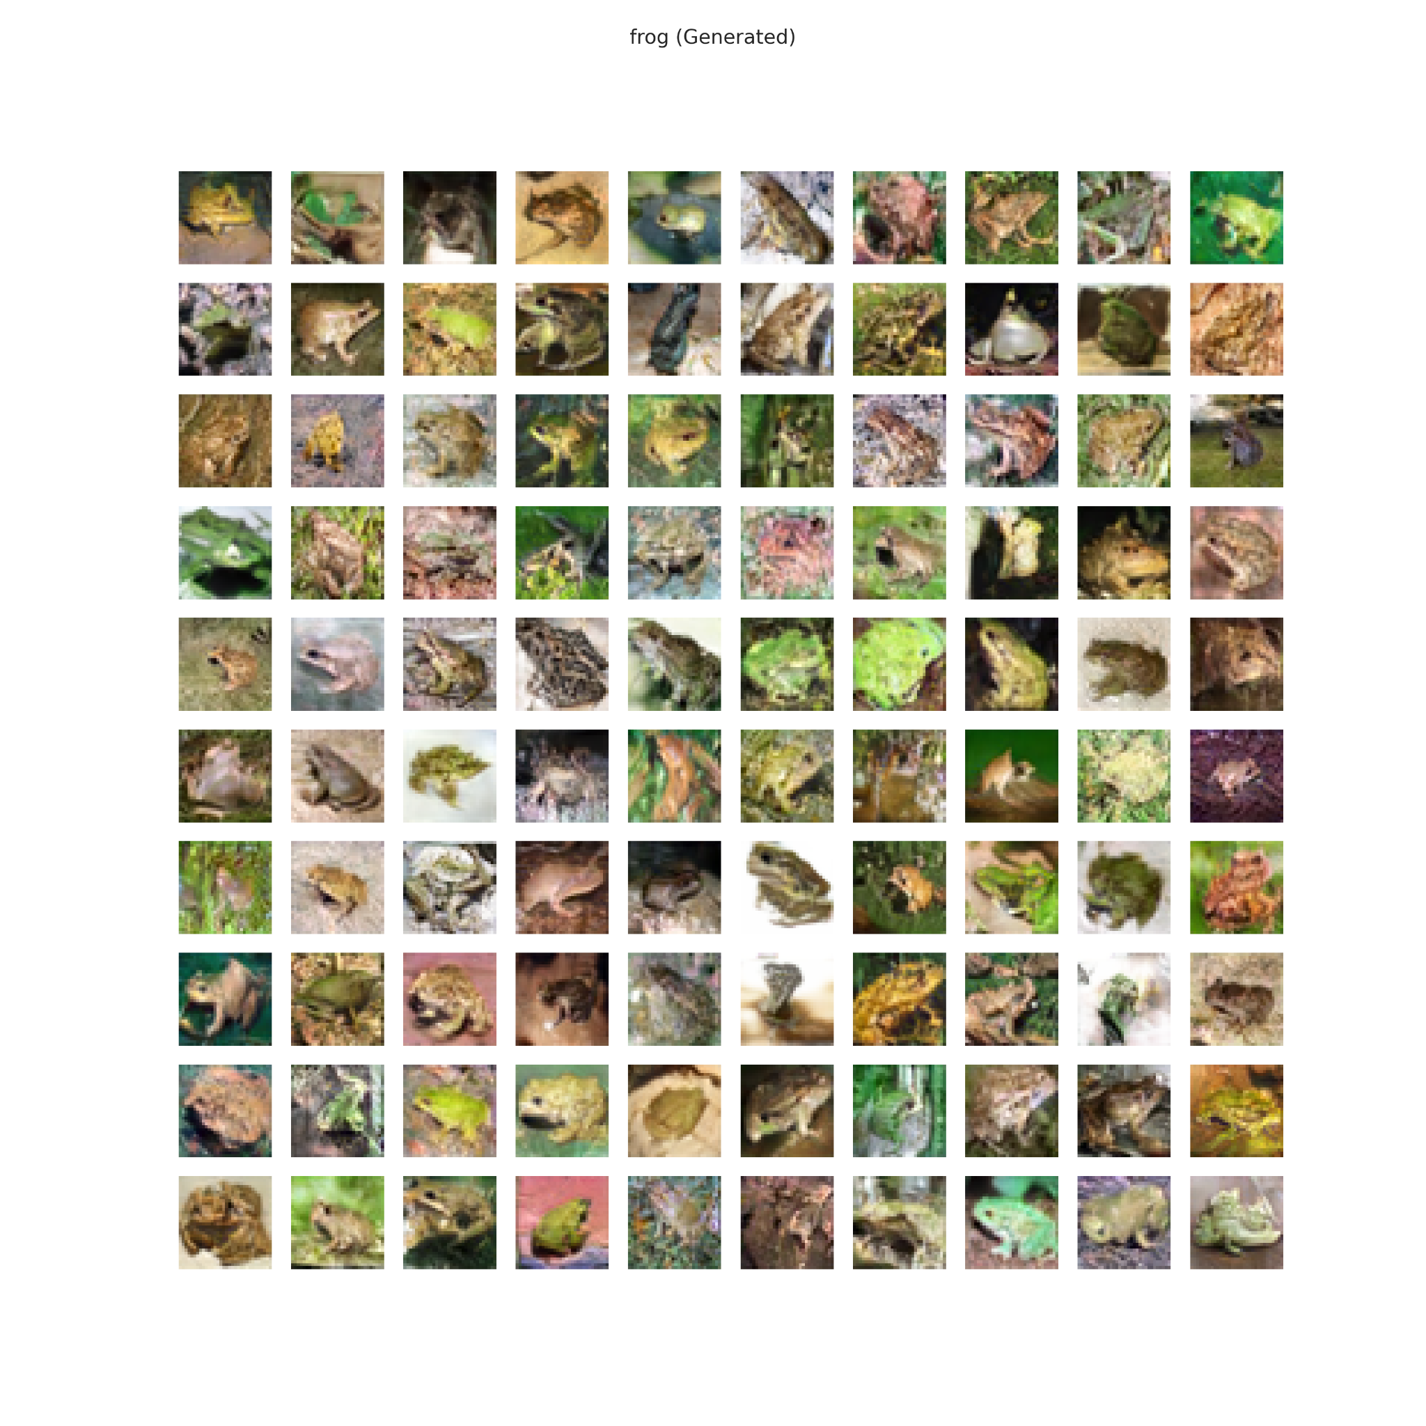
6.0) Images Generated
–> ./images/submission/GAN_100_Generated_{class}

Slide 12
6.0) Image Generation
Go to `./images/submission/GAN_100_Generated_{class}`to see a higher quality of the images shown..

Slide 13
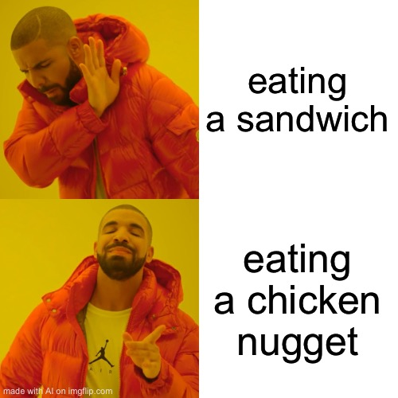

Conclusion
In the assignment, I made progress by building different GAN models, starting from simple ones and gradually increasing their complexity. This allowed me to improve the quality of my generated images from poor to good. To achieve this improvement, I used advanced architectures and methodologies, which is referred to as a "horizontal" improvement, rather than fine-tuning hyperparameters, known as a "vertical" improvement. I tried different architectures and loss functions to get better results. I also used evaluation metrics like inception score and FID to measure the quality of the generated images and guide further improvement. I employed the truncation trick to select high-quality images. Overall, the assignment was a learning experience with GANs and focused on achieving better image generation results.
AI Generation memes

Slide 14
Thanks!
Fin. 完。
Please keep this slide for attribution

